Slide 1
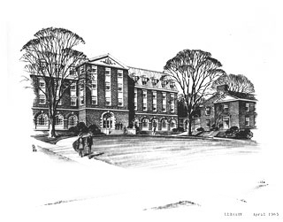
Barry Cull, Information Services Librarian Harriet Irving Library January 2011
Avoiding Plagiarism
lib.unb.ca

Slide 2
At the end of this workshop you should be able to:
Generally know how to avoid plagiarism in essays and other writing assignments.
Understand the general conventions of academic citation.
lib.unb.ca

Slide 3
Plagiarism happens at university and beyond. Doesn’t everybody do it?
lib.unb.ca

Slide 4
“If I have seen further it is by standing on the shoulders of giants.”
Isaac Newton, letter to Robert Hooke,
5 February 1676
lib.unb.ca

Slide 5
New discoveries are usually built upon the work of previous researchers.
lib.unb.ca

Slide 6
“If you steal from one author, it’s plagiarism; if you steal from many, it’s research.”
Wilson Mizner (1876–1933), U.S. dramatist
lib.unb.ca

Slide 7
But is it really “stealing” when you are doing research?
lib.unb.ca

Slide 8
Yes, it is theft. It is also academic fraud. Specifically, it is plagiarism, unless you give credit to those authors whose works you use.
lib.unb.ca

Slide 9
“If you steal from one author, it’s plagiarism; if you steal from [refer to] many, it’s research.”
lib.unb.ca

Slide 10
According to the Oxford English Dictionary, to plagiarize is “to take and use as one's own (the thoughts, writings, or inventions of another person).”
lib.unb.ca

Slide 11
The UNB Undergraduate Calendar defines it as including the following: “1. Quoting verbatim or almost verbatim from a source (such as copyrighted material, notes, letters, business entries, computer materials, etc.) without acknowledgment; 2. Adopting someone else's line of thought, argument, arrangement, or supporting evidence (such as, for example, statistics, bibliographies, etc.) without indicating such dependence; 3. Submitting someone else's work, in whatever form (film, workbook, artwork, computer materials, etc.) without acknowledgment; 4. Knowingly representing as one's own work any idea of another.”
lib.unb.ca

Slide 12
To summarize, in academic writing, if you: (1.) copy or paraphrase another person's words, or (2.) adopt their ideas or data, without giving credit by citing the source, then you are plagiarizing —whether you had intended to cheat or not.
lib.unb.ca

Slide 13
There are four major standard citation styles: APA: social sciences, and beyond MLA: humanities Chicago: humanities, especially history CSE: sciences Other styles are common in specific disciplines, such as CJCHE and AICHE in chemical engineering.
lib.unb.ca

Slide 14
Is avoiding plagiarism the only reason
why you need to cite sources?
lib.unb.ca

Slide 15
There are three other inter-related reasons why academic authors use citations:
Further reading
Provide evidence
Demonstrate knowledge
of the literature
lib.unb.ca

Slide 16
Why are there standard citation styles?
lib.unb.ca

Slide 17
And to indicate: 1 – Type of source 2 – Point in time accessed
To allow another person to
quickly locate your sources.
lib.unb.ca

Slide 18
Kirsh, S. J. (2006). Cartoon violence and aggression in youth. Aggression and Violent Behavior, 11(6), 547-557. doi:10.1016/j.avb.2005.10.002
APA uses the author-date in-text citation method (Kirsh, 2006, p.550). An alphabetical reference list appears at the end of your paper:
References
lib.unb.ca

Slide 19
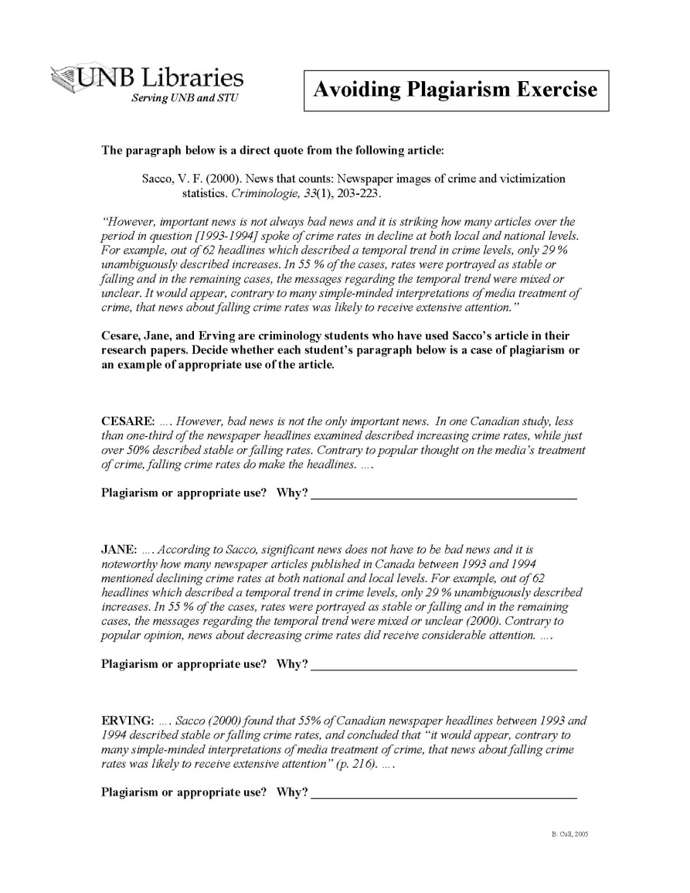
Avoiding Plagiarism Exercise: APA In-Text Citations
lib.unb.ca

Slide 20
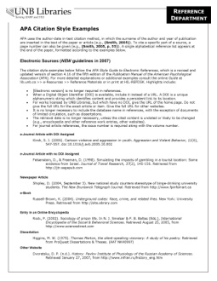
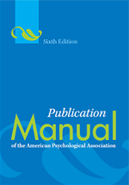
Copies of the citation manuals for reference: APA Publication Manual (6th Edition) HIL-REFDSK ENG-REF SCI-REF BF76.7 .P83 2010
For standard styles, the library provides:
Websites/handouts on reference lists & in-text citations, with examples
lib.unb.ca

Slide 21
“If we want to understand how it is that people design skyscrapers, or write music, or write a New York Times best seller, I think we need to acknowledge that nothing we design is ever truly novel—every creative effort contains vestiges of what we have experienced in the past.”
Richard L. Marsh, University of Georgia
lib.unb.ca

Slide 22
Are there no original thoughts?
lib.unb.ca

Slide 23
Yes, but your thoughts are often influenced by ideas you have previously encountered.
lib.unb.ca

Slide 24
So do we need to worry about things we previously read, but that we forgot we read?
lib.unb.ca

Slide 25
No, just keep track of sources during your research.
lib.unb.ca

Slide 26
Tools to keep track of sources, and automatically create standard citations: - RefWorks - Zotero (Firefox browser extension) - MS Word’s Citations & Bibliography feature - QuickBib (only available via the library’s CSA Illumina journal article databases)
lib.unb.ca

Slide 27
Always double-check automatically- generated bibliographies using an examples website or style manual!
lib.unb.ca

Slide 28
Some Final Tips for Avoiding Plagiarism…
lib.unb.ca

Slide 29
1: Start your research early.
lib.unb.ca
Notes:
Expect the library research process for most research papers to take much longer than the writing process.

Slide 30
2: Get full citations when doing research.
lib.unb.ca
Notes:
Be sure you have all the bibliographic details (title, author, journal title, volume, issue, pages, etc.) when printing or emailing source documents, or when taking notes.

Slide 31
3: Paraphrase properly.
lib.unb.ca
Notes:
If you summarize a passage of text, use your own words, and cite the source. Only use quotation marks for verbatim quotes.

Slide 32
4: Cite any text copied word-for-word, and use quotation marks.
lib.unb.ca
Notes:
If you summarize a passage of text, use your own words, and cite the source. Only use quotation marks for verbatim quotes.

Slide 33
5: Use paraphrases and quotes sparingly.
lib.unb.ca
Notes:
Avoid citing secondary sources that do not add weight to your own argument.

Slide 34
6: Do not cite “common knowledge”.
lib.unb.ca
Notes:
Avoid citing secondary sources that do not add weight to your own argument.

Slide 35
7: For specific help, visit the Writing Centre.
lib.unb.ca
Notes:
Avoid citing secondary sources that do not add weight to your own argument.

Slide 36
For more information see:
Plagiarism: A How-NOT-to Guide
lib.unb.ca/research/Plagiarism.html
Recommended academic writing handbooks:
lib.unb.ca/research/PlagiarismBibliography.html

